Slide 1
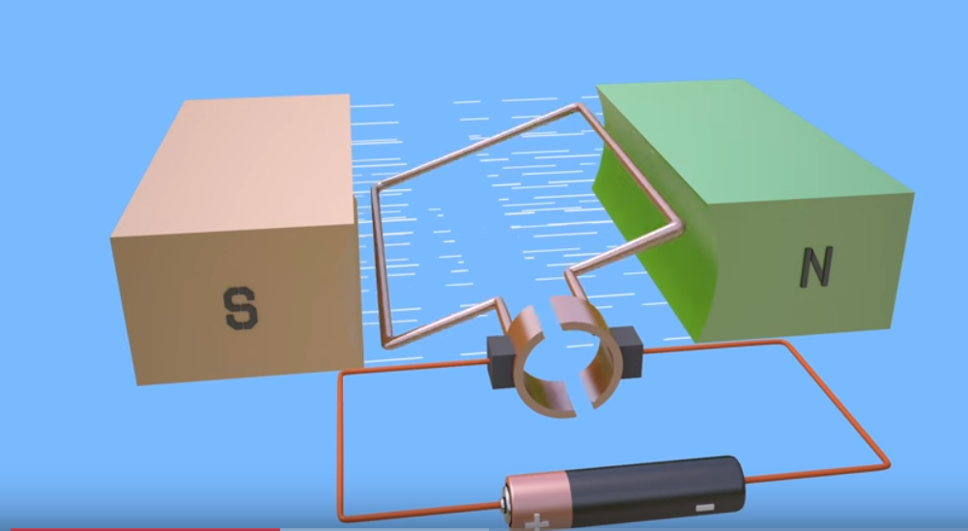
DC MOTOR THEORY OF OPERATION
A motor is an electrical machine which converts electrical energy into mechanical energy.
Take a wire and put it between the poles of a powerful, permanent horseshoe magnet.
Connect the two ends of the wire to a battery, the wire will move briefly.
When current pass through, it creates a magnetic field around it.
If we place the wire near a magnet, this magnetic field interacts with the permanent magnet's field.
It’s like putting two magnets near one another, they will repel or attract.
In the same way, the temporary magnetism around the wire attracts or repels the permanent magnetism from the magnet, and that's what causes the wire to move.
https://www.youtube.com/watch?v=j_F4limaHYI

Slide 2
DC MOTOR THEORY OF OPERATION
The principle of working of a DC motor is that "whenever a current carrying conductor is placed in a magnetic field, it experiences a mechanical force".
Magnetic field may be provided by field winding (electromagnetism) or by using permanent magnets.
https://www.electricaleasy.com/2014/01/basic-working-of-dc-motor.html

